Slide 1
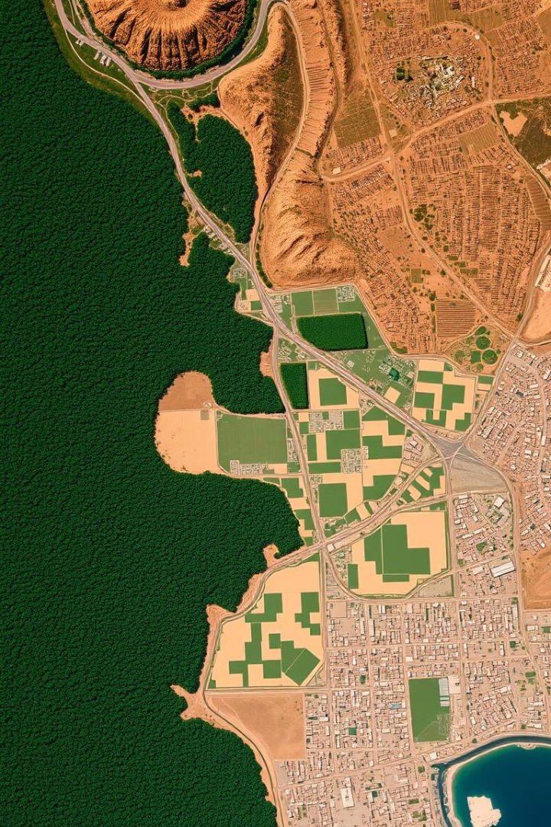
Land Cover Classification Presentation
Presentation about Land cover Classification (AI Project presentation)

Slide 2
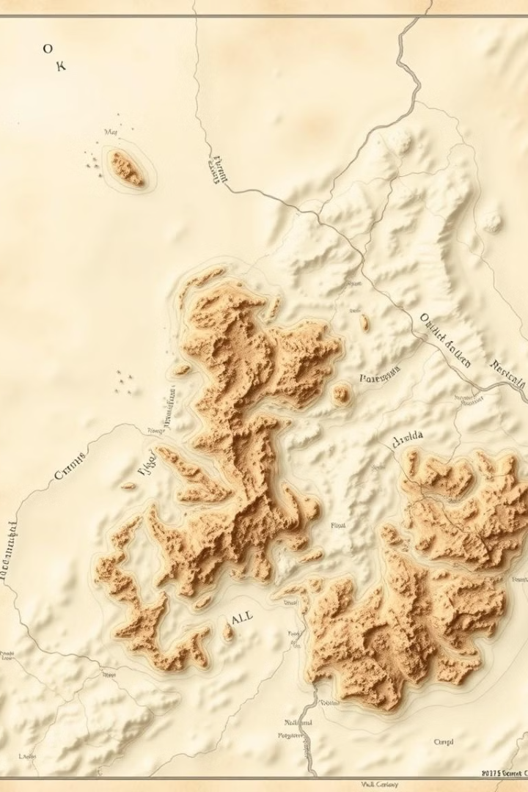
Project Overview
Mission
Goal
The mission of this project is to accurately classify different land cover types, such as forests, croplands, and urban areas, using satellite imagery.
To develop a fast, robust and reliable machine learning model that can quickly and accurately identify and map different land cover types.

Slide 3
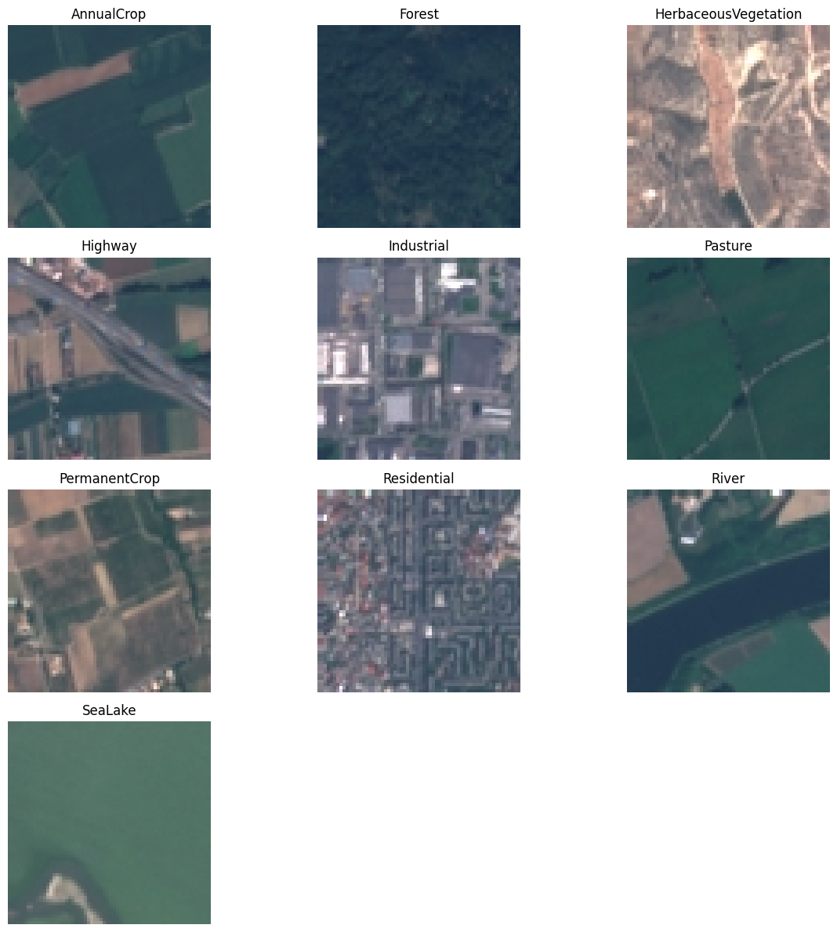
Data & Preprocessing
Data Split
Preprocessing
The dataset used was EuroSAT, consists of satellite imagery labeled with 10 different land cover classes, such as deciduous forests, grasslands, and built-up areas.
Split:-70% Training || 20% Validation || 10% Testing
The images were resized to a common size(64x64) and normalized to improve the model's performance and generalization.
Classes: ['AnnualCrop', 'Forest', 'HerbaceousVegetation', 'Highway', 'Industrial', 'Pasture', 'PermanentCrop', 'Residential', 'River', 'SeaLake’]
Number of samples per class: [2400,2400,2400,2000,2000,1600,2000, 2400,2000,2400]

Slide 4
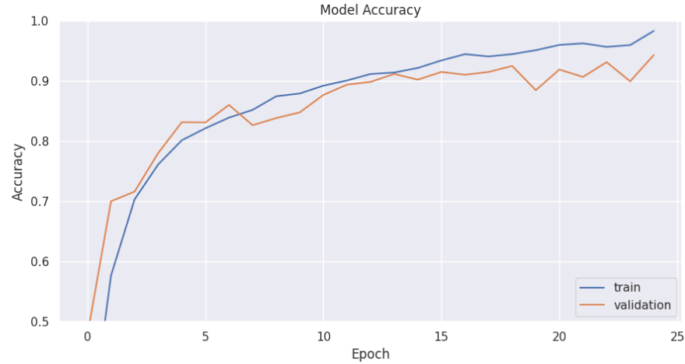
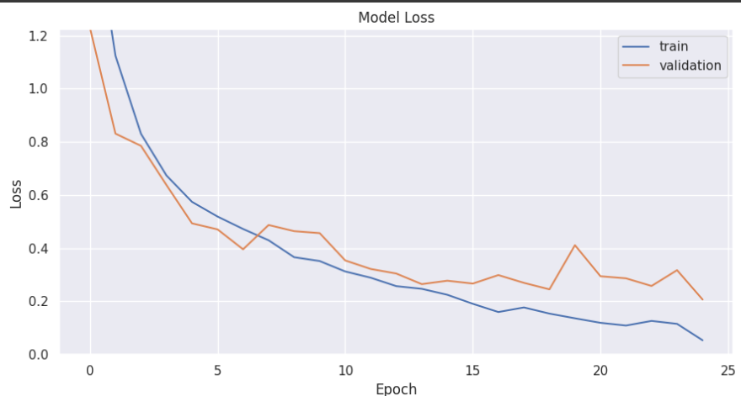
Model Development
1
Baseline Model
The project started with a baseline convolutional neural network (CNN) model, which achieved an initial accuracy of 82%.
2
Iterative Improvements
Our team experimented with changing to VGG16, which raised the bar and gave a solid 94%+ accuracy.
3
Transfer Learning and further improvements
We moved ahead with transfer learning approach, applying it over 3 different networks with image-net weights getting close to state- of-art results surpassing 98% mark. Further, We experimented with some adversial attack techniques to test robustness.

Slide 5
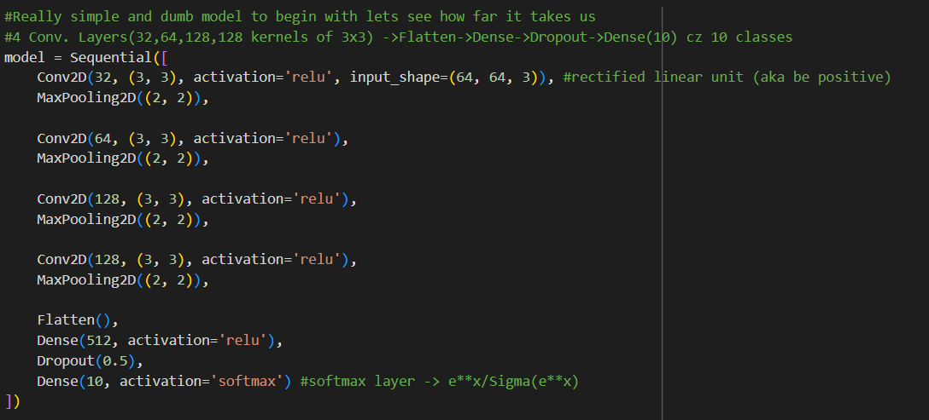
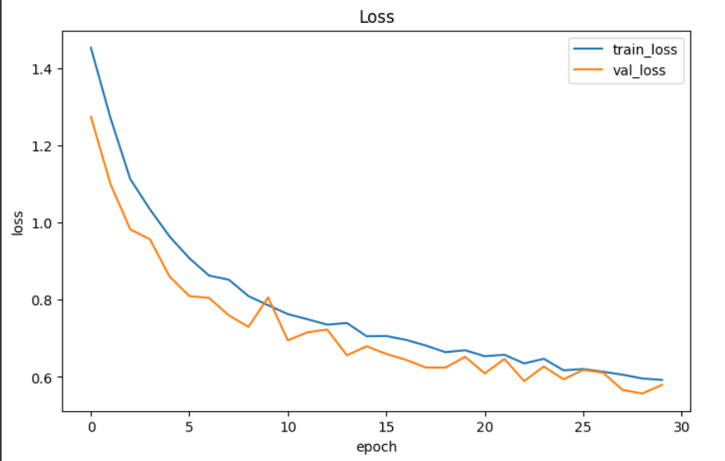
Evaluation & Analysis
Shallow CNN model (Trial-1)(~79% accuracy)

Slide 6
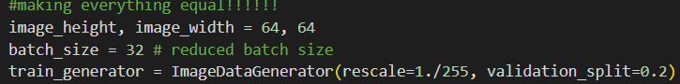
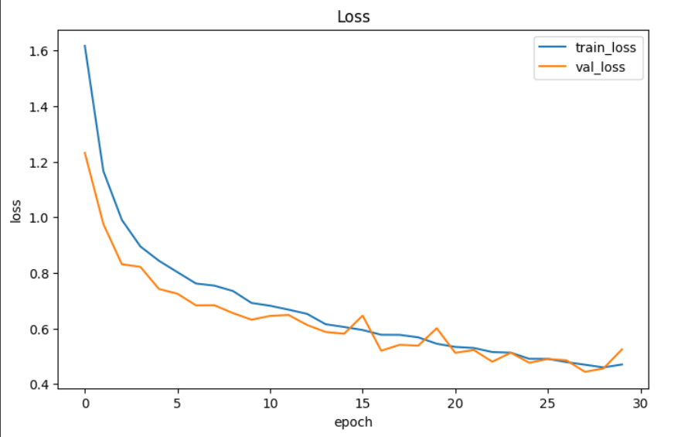
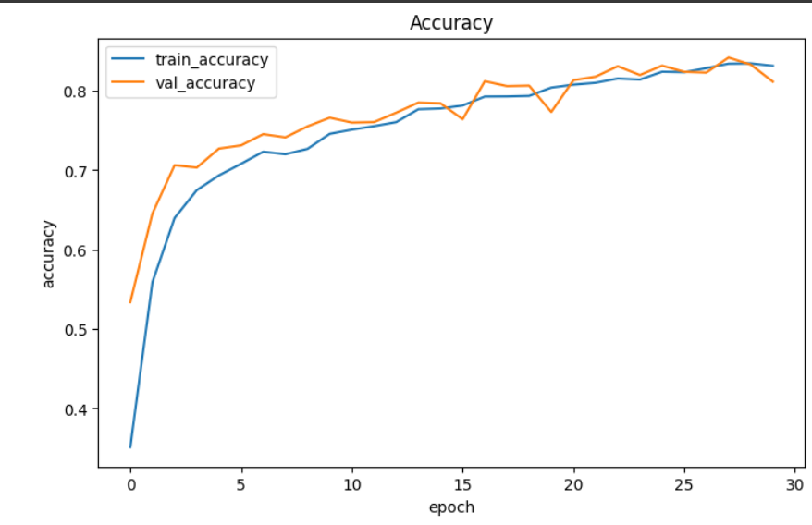
Evaluation & Analysis
Shallow CNN model (Trial-2)(~82% accuracy)
Batch-size reduced from 64 to 32

Slide 7
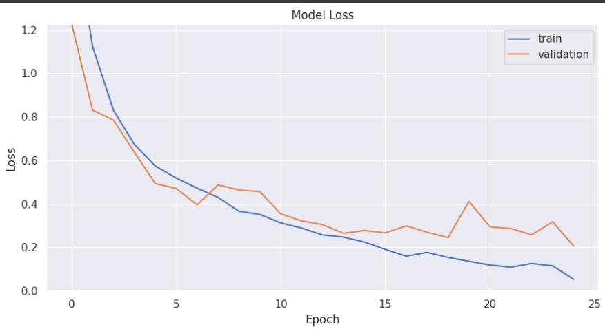
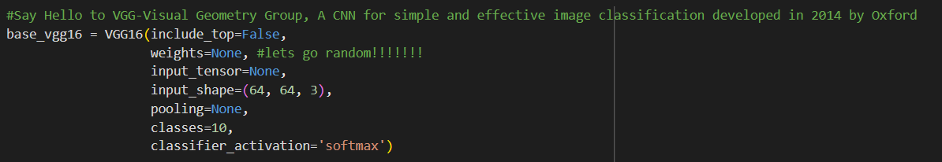
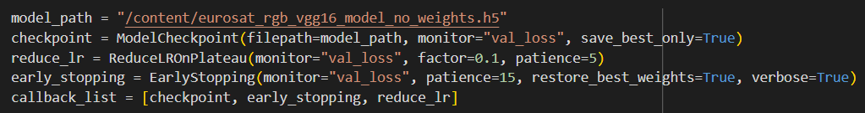
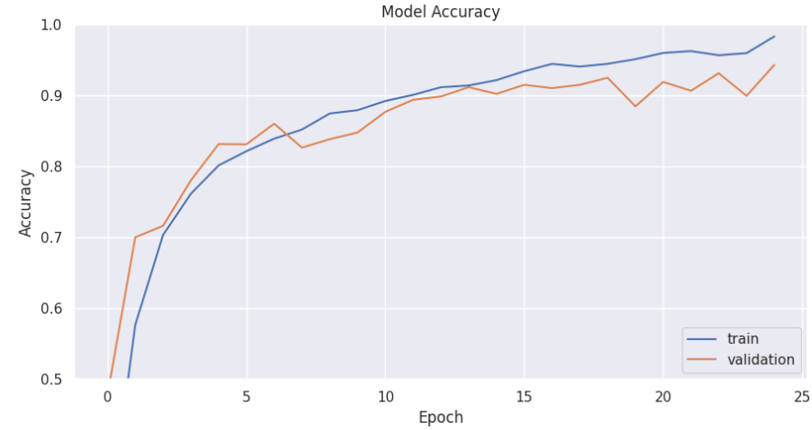
Evaluation & Analysis
VGG16 without pre-training (94%+ accuracy)
13 Conv Layers 3 Fully connected layers in VGG16

Slide 8
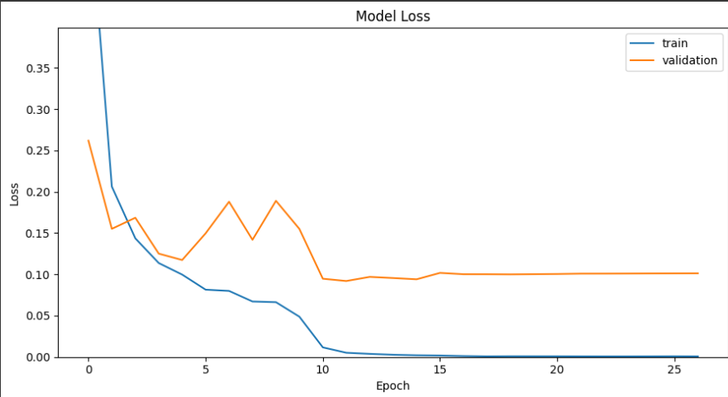
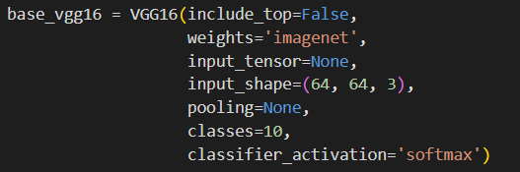
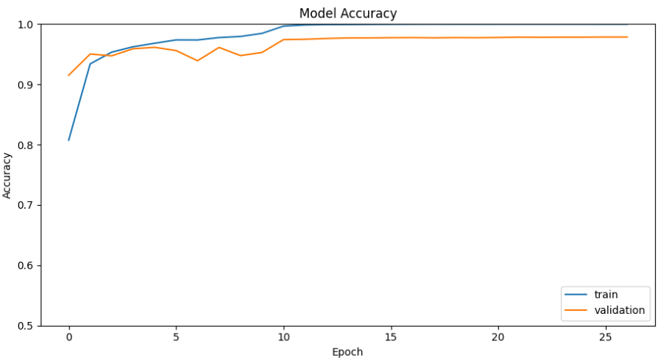
Evaluation & Analysis
VGG16 with pre-training (98%+ accuracy)
Possibility of overfitting having occurred, can not be absolutely sure due to 98% accuracy but a better model may help in much more robust results, we will dwell into the territory of robustness too for a short period later.

Slide 9
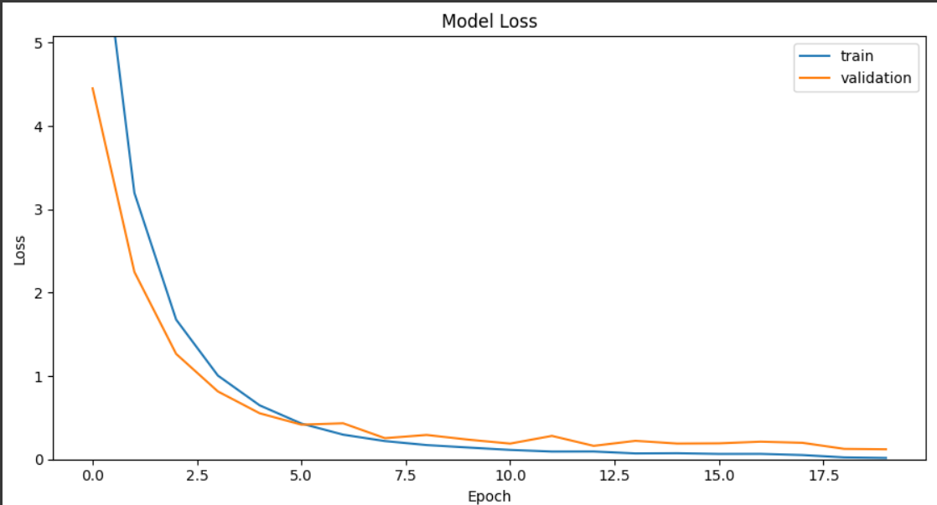
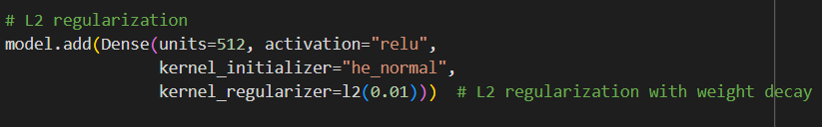
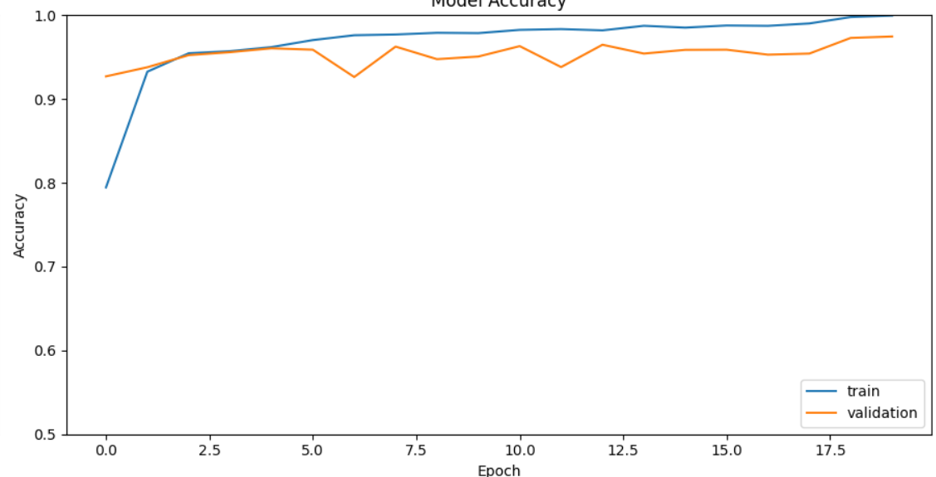
Evaluation & Analysis
VGG16 with pre-training (98%+ accuracy)
Use of L2 Regularization(Ridge regularization)
No major improvement in accuracy but we will shortly see a major advantage of applying regularizers.

Slide 10
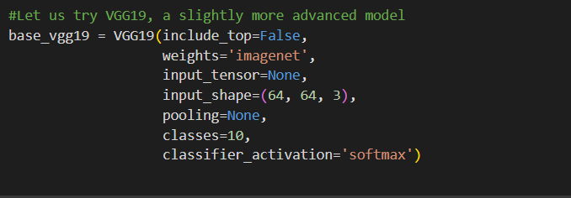
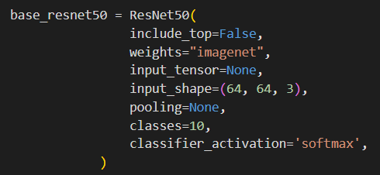
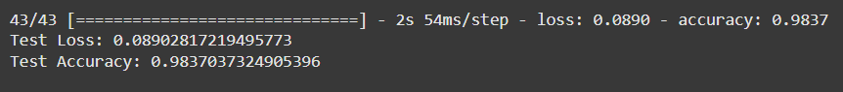
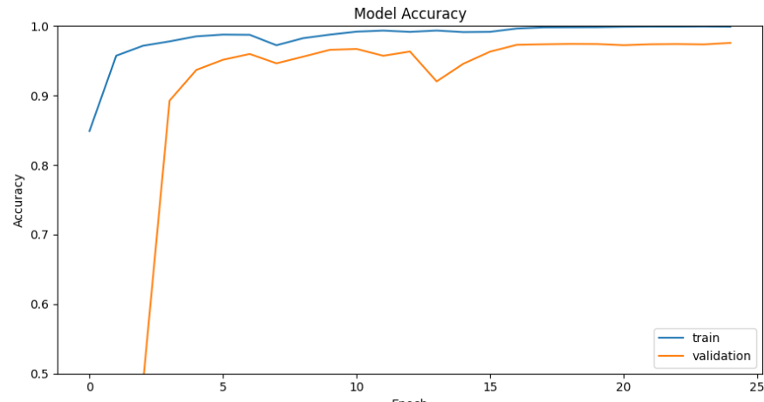
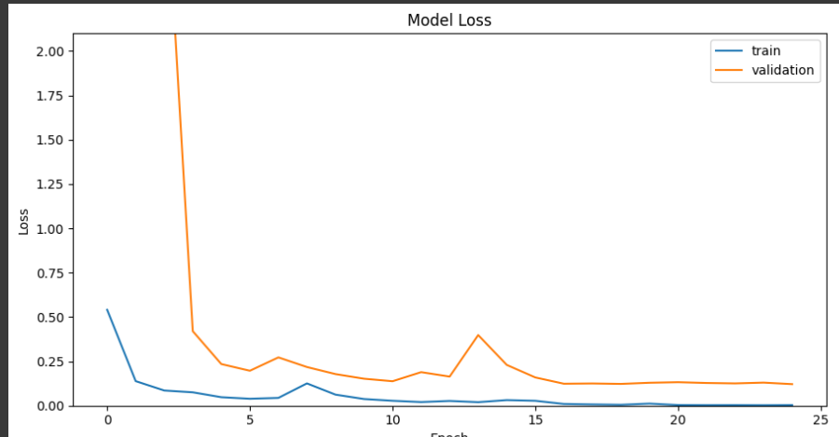
Evaluation & Analysis
VGG19 with pre-training (98.25%+ accuracy)
ResNet50 with pre-training(~98.4% accuracy)
We were able to achieve near state of art performance with VGG19 and VGG16, as well as confirmed the paper’s finding about ResNet50 by achieving accuracy around the benchmark levels.
Goes on to show that VGG16 and VGG19 models are able to reach state-of-art performances despite being much shallower.

Slide 11
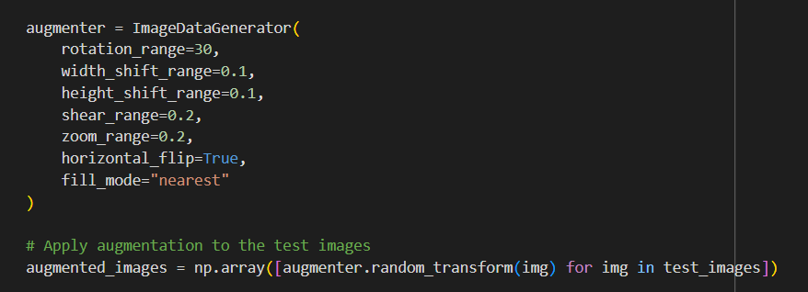
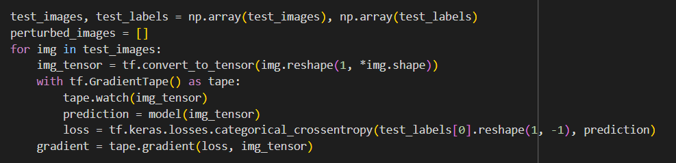
Evaluation & Analysis
Adversial attacks
AugMix-Like adversial data
FGSM adversial attack method
Effect on vanilla VGG19(~81% only)
Not a large drop on VGG19(non regularized version). ~95% accuracy.
So, We worked upon more advanced adversial attacking methods.

Slide 12
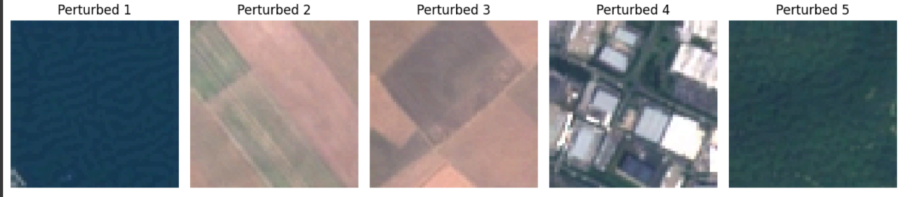
Evaluation & Analysis
Adversial attacks
FGSM adversial attack method
Effect on vanilla ResNet(~84% accuracy)
Effect on regularized VGG16(~87%)
Still a Loss of around 15% for untargeted attacks along with a large loss. Improvement on robustness due to more trainable parameters/layers.
Good statistics keeping in consideration the number of trainable parameters. L2 regularization makes model much more robust.

Slide 13
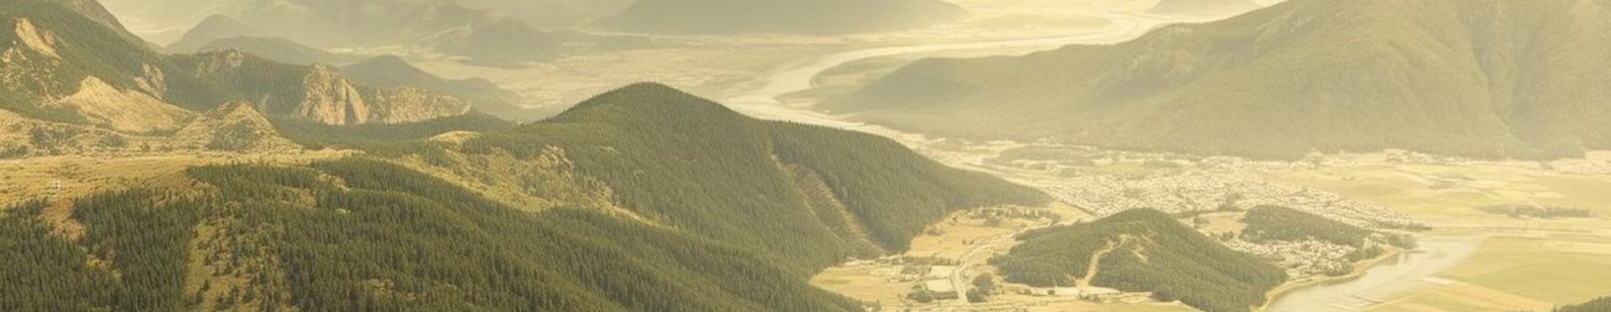
Conclusion
This project successfully showed VGG16 model’s ability to provide a near- state-of-art and robust enough solution to the problem of classification of land through satellite imagery, through EuroSAT dataset. The land type detection can find various use cases in field of technology, agriculture and city planning.

